Slide 1
AgriSense
Smart Irrigation System Using ML & IOT
ANSHU KUMAR(2401EC59,COORDINATOR)
ABHISHEK RAJ(2401EC57)
AYUSH KUMAR(2401EC58)
PURUSHOTTAM KUMAR(2401EE41)

Slide 2
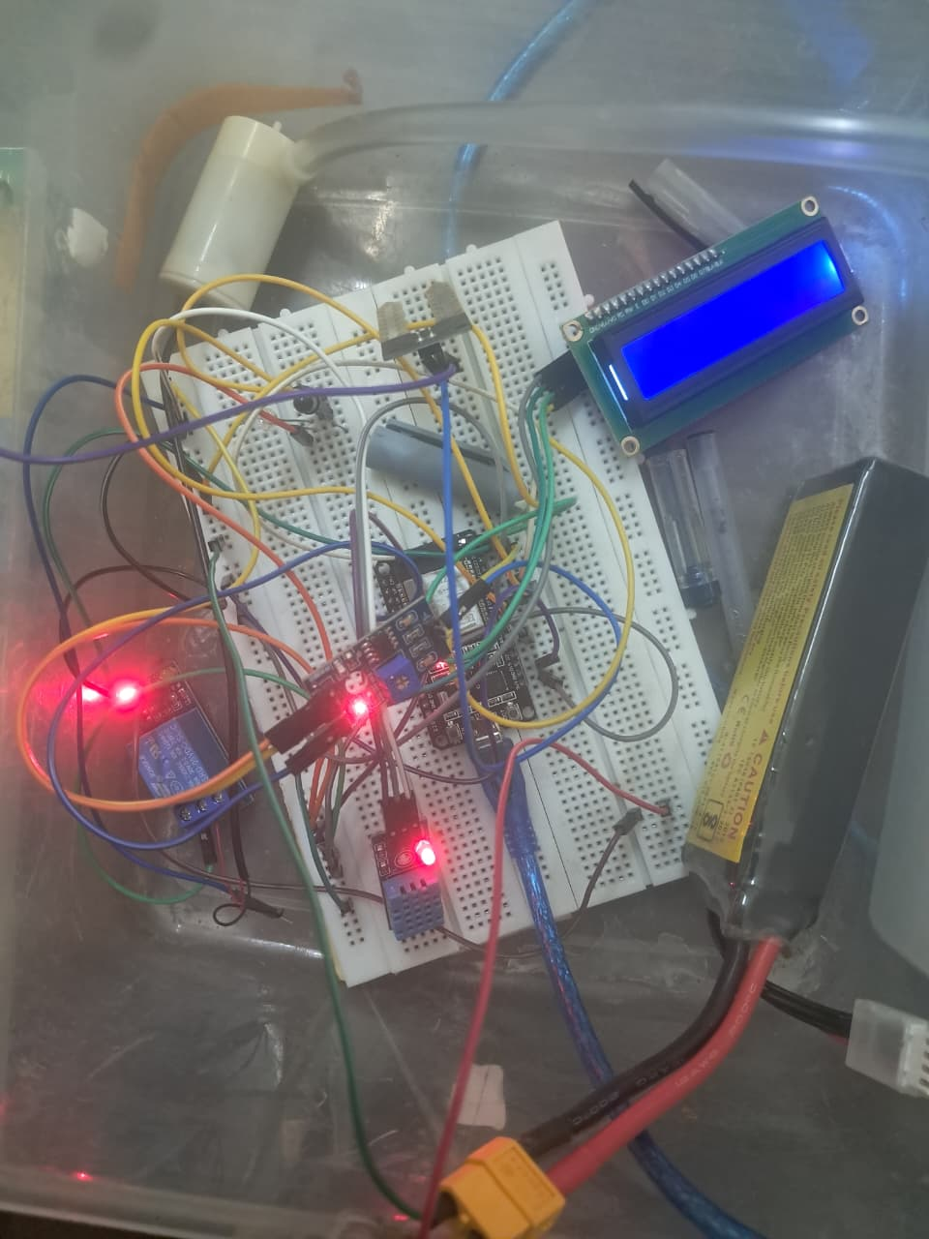
Problem Statement
70%
40%
60%
of global freshwater goes to agriculture
water wasted due to over-irrigation
farmers rely on manual / guesswork methods
Current Challenges & Motivation:
Manual irrigation is time-consuming and imprecise
Lack of real-time soil monitoring leads to crop damage
No intelligent decision-making based on environmental data
High water bills and resource wastage in traditional farms

Slide 3
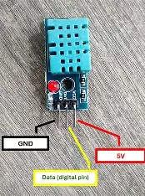
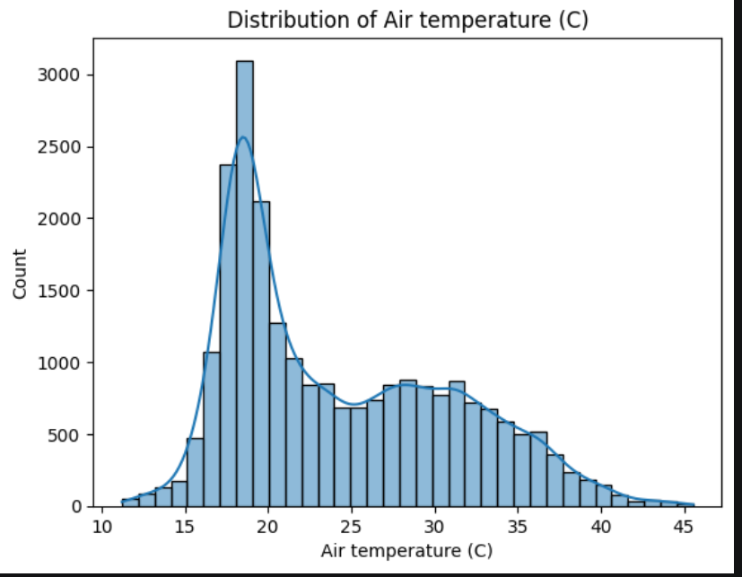
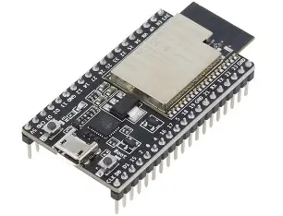

Our Solution – AgriSense
SENSORS
MODEL
CONTOLLER
DASHBOARD
Smart Sensors
AI/ML Model
DHT11 Soil Moisture & Temperature
sensors capture real-time
environmental data
Model predicts
pump ON/OFF with high
accuracy
ESP32 microcontroller
communicates via Flask
API on cloud
Blynk app + ThingSpeak
for live monitoring and
manual override
AgriSense = Sensors + ESP32 + AI Model + Cloud API + Dashboard

Slide 4
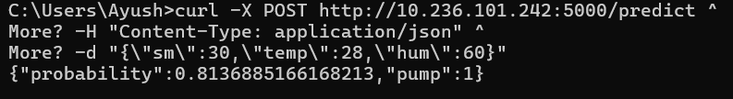
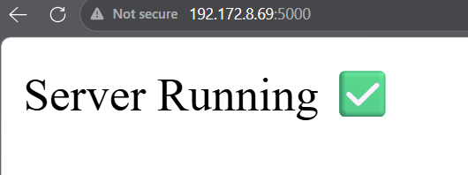
System Architecture
XGBoost
Model
DHT11
Sensor
→
→
→
ESP32
Microcontroller
Flask API
Blynk +
ThingSpeak
Soil
Moisture
Sensor
Pump
Relay
Data Flow: Sensors → ESP32 → Cloud API → XGBoost Prediction → Control Pump

Slide 5
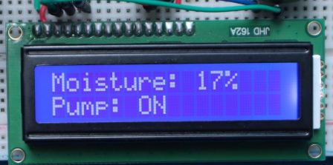
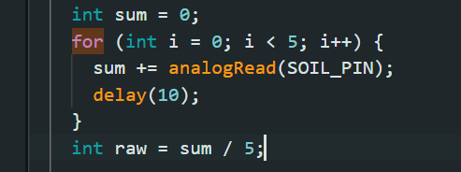
Hardware Components
ESP32 WROOM
DHT11 Sensor
Main microcontroller with WiFi + BT
Measures air temperature & humidity
WiFi via 802.11 b/g/n
Data → GPIO 4
Soil Moisture Sensor
Relay Module
Reads soil water content
Controls water pump ON/OFF
Analog → GPIO 34
Control → GPIO 23
LCD I2C 16×2
Displays real-time sensor readings
SDA→21 SCL→22

Slide 6
ML Models Explored
We evaluated multiple ML models before selecting XGBoost:
Logistic Regression
73.9%
Simple baseline model, fast but limited accuracy
Linear Regression
72.8%
Not ideal for classification, may give unstable predictions
Random Forest
73.4%
Robust and accurate, but slower in prediction
SVM
74.8%
Good accuracy, works well for small datasets
INITIALLY WE STARTED OUR PROJECT WITH THINKING AS SVM MODEL WOULD BE BEST BUT LATER ON PERFORMING EDA WE SAW THRE CAN BE MORE BETTER MODELS AS WELL LIKE XGBOOST.
XGBoost
84%
Best accuracy + speed – SELECTED, also its performance is faster

Slide 7
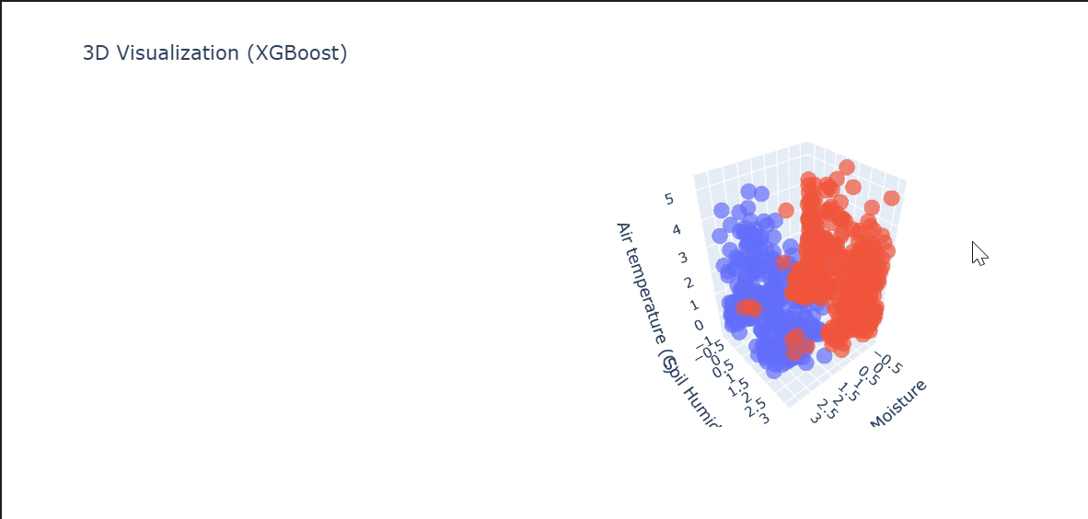
Why XGBoost? — Deep Dive
How XGBoost Works
Our Model Performance
Gradient Boosted Decision Trees
Sequentially builds weak learners
Each tree corrects previous errors
Regularization prevents overfitting
Handles tabular data extremely well
Fast training & inference speed
Below is a Video demonstration on how it classifies
Accuracy
84%
Precision
91%
Recall
78%
F1-Score
0.84
Features
4
Training Set
TARP Dataset

Slide 8
Dataset & Input Features
Dataset: TARP Moderate Confidence Dataset
Feature 1: Soil Moisture
Represents the actual water content present in the soil
It is the most important factor for irrigation decisions
Range: 0 – 100%
Feature 2: Soil Humidity
Acts as a supporting indicator for soil moisture
Helps validate and cross-check moisture readings
Range: 0 – 100%
Feature 3: Air Temperature
Influences how much water plants need
Range: -10°C to 60°C
Shows the overall confidence of the environment for proper irrigation decisions.
Helps simulate real-world agricultural scenarios

Slide 9
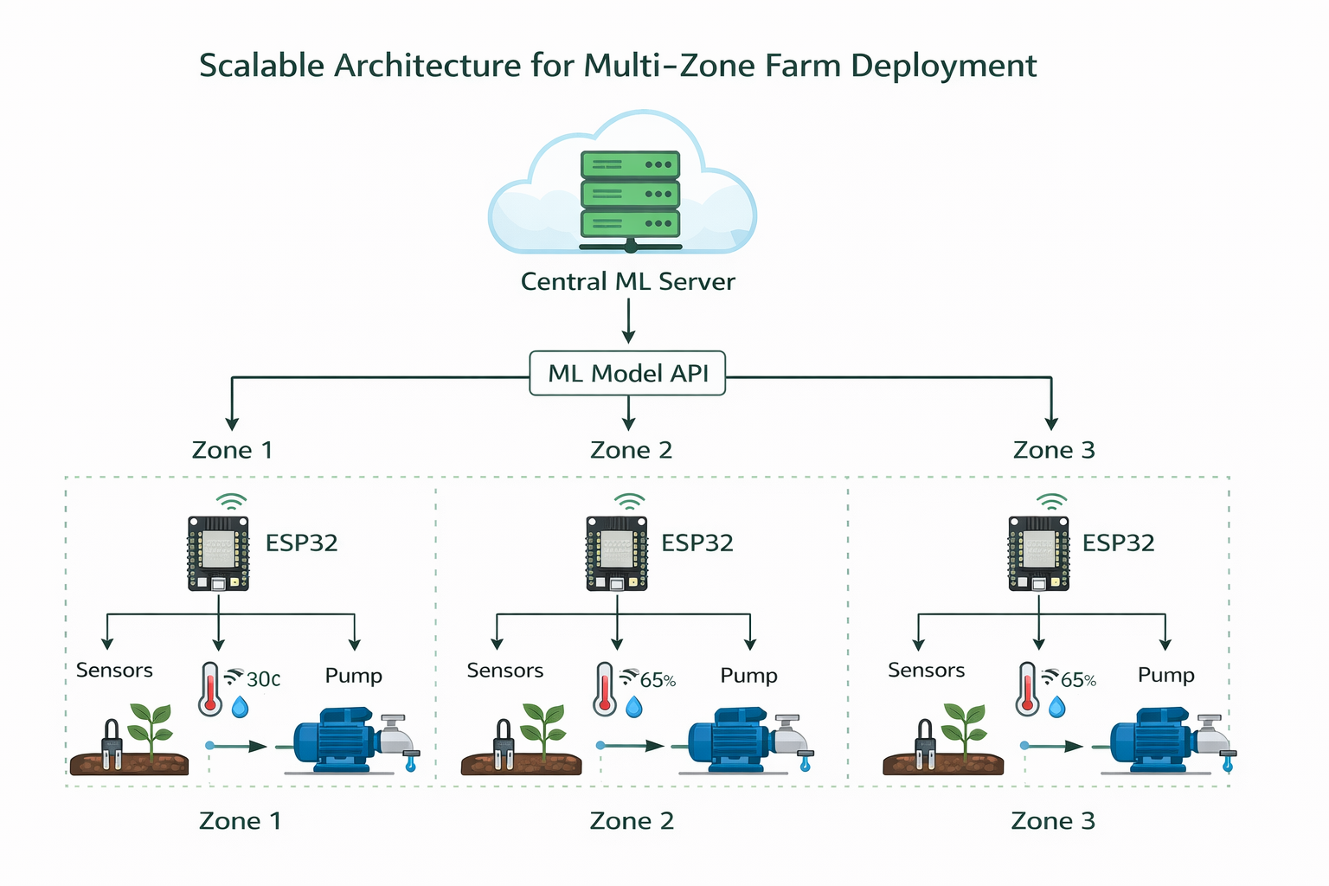

Slide 10
Flask Backend & API
API Endpoints
Security & Logic
GET /
API key authentication (X-API-Key header)
Input validation for all sensor ranges
Feature engineering applied before scaling
joblib model + scaler + threshold loaded on startup(joblib model as pkl file)
CORS enabled for cross-origin ESP32 calls
Returns: pump_status, confidence, threshold
COMMAND IN CMD FOR CHECKING RUNNING OR NOT
curl -X POST http://10.236.101.242:5000/predict ^
-H "Content-Type: application/json" ^
-d "{\"sm\":30,\"temp\":28,\"hum\":60}"
Checks whether the server is running properly
GET /test
Used to verify API connectivity and debugging
POST /predict
Main endpoint — returns pump decision
GET /predict
Fallback GET — for query-param testing

Slide 11
ESP32 Firmware Logic
WiFi + Blynk Connect
Read Sensors
01
02
Connects to WiFi, authenticates Blynk IoT dashboard
DHT11 reads temp/humidity; soil pin reads raw ADC value
API Call (Flask)
Parse Response
03
04
Sends POST request with sensor JSON data
Extracts pump_status & confidence from Flask response
Control Relay
Update Dashboard
05
06
Sets relay HIGH/LOW to turn pump ON or OFF accordingly
Writes to Blynk virtual pins and ThingSpeak fields

Slide 12
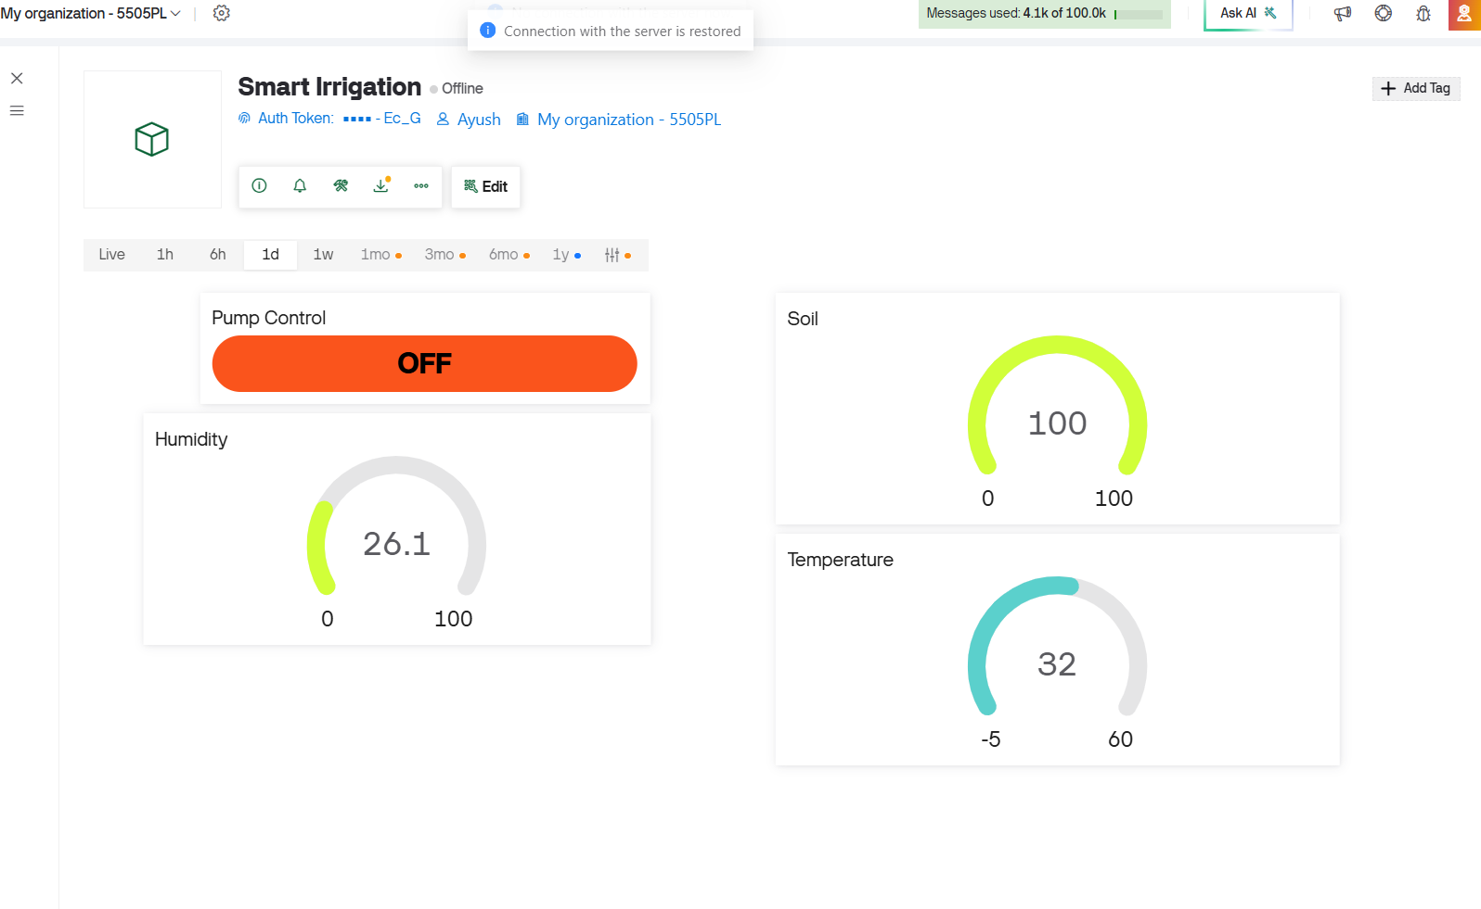
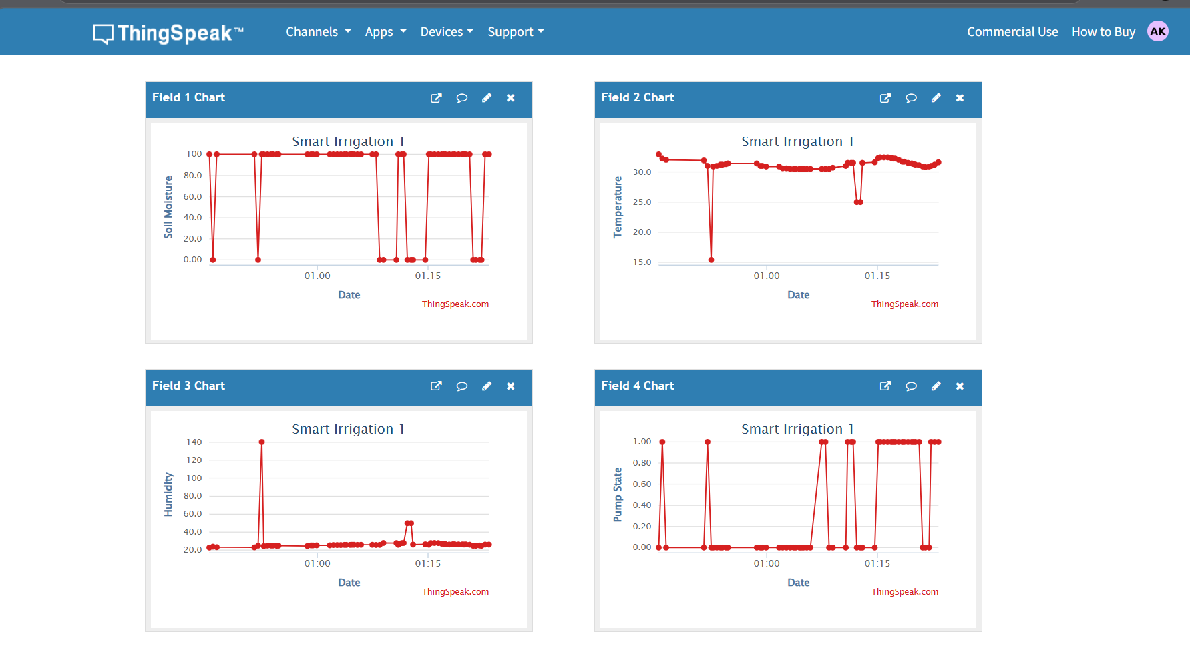
IoT Dashboards — Blynk & ThingSpeak
Blynk IoT
ThingSpeak
V0 – Pump switch label
V1 – Humidity
V2 – Soil Moisture
V3 – Temperature
Field 1 – Soil Moisture (%)
Field 2 – Humidity (%)
Field 3 – Air Temperature (°C)
Field 4 – Pump Status(0/1)

Slide 13
Results & Performance
84%
10s
<2s
40%
Model Accuracy
Sensor Read Interval
API Response Time
Estimated Water Saved
Additional Observations:
Manual override via Blynk V5 allows real-time operator control
LCD displays live soil moisture and pump status on-field
LED indicators provide visual confirmation of pump state
ThingSpeak graphs show historical trends for analysis

Slide 14

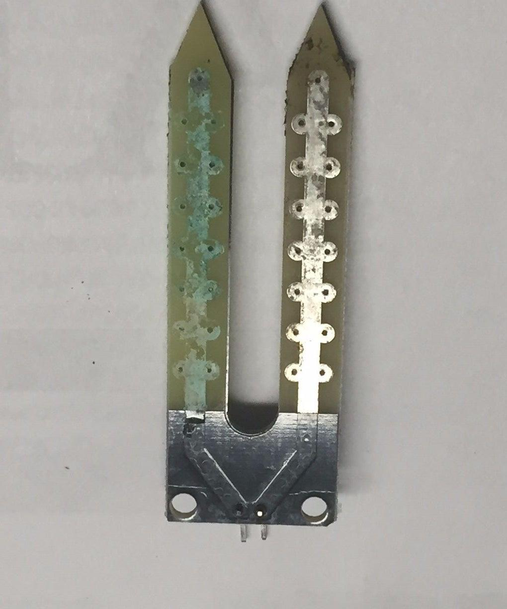
Challenges & Future Scope
Challenges Faced
Future Enhancements
URL changes on every restart — needs updating in firmware
DHT11 occasional NaN readings required retry logic
HTTP vs HTTPS redirect required custom handling in ESP32
TARP dataset needed feature engineering to improve accuracy
Calibrating soil sensor for different soil types was complex
Capacitive soil moisture sensor showed durability issues (prone to rust/corrosion over time in wet soil)
Fixed public cloud deployment (AWS / GCP)
Weather API integration for rain prediction
Multi-zone irrigation with separate pump zones
Solar-powered autonomous operation
Mobile app with AI chatbot assistant for farmers
Integration of NPK (Nitrogen, Phosphorus, Potassium) sensors to monitor soil nutrient levels for better crop management

Slide 15
Conclusion
AgriSense successfully demonstrates how AI + IoT can transform traditional irrigation:
✅ 84% accuracy using XGBoost on real TARP sensor data
💧 Intelligent water management reduces wastage by ~40%
📡 End-to-end IoT pipeline from ESP32 to cloud API
📊 Real-time monitoring via Blynk & ThingSpeak dashboards
🔄 Fallback logic ensures system works even without internet
🌍 Scalable architecture for multi-zone farm deployment

Slide 16
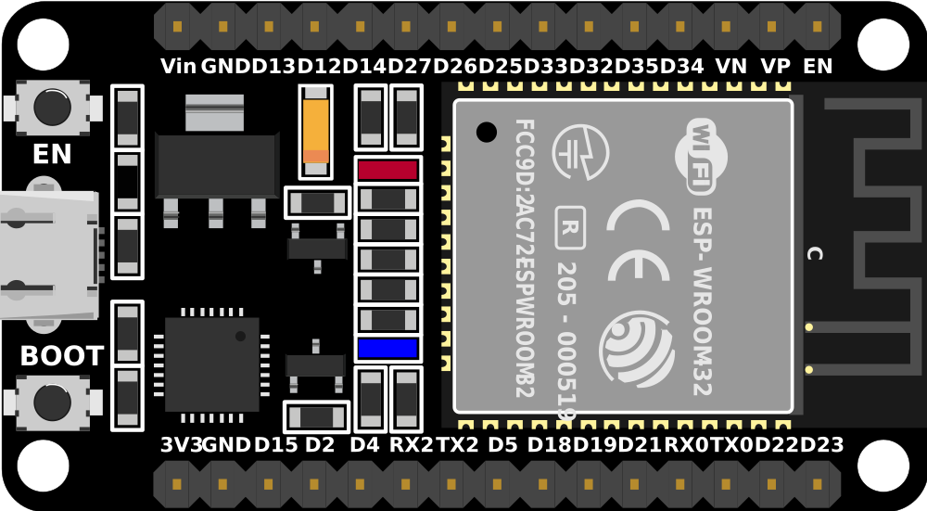
ESP 32 PIN DIAGRAM FOR REFERENCE
FOR RELAY MODULE WE USED PIN 23 FOR TEMPERATURE SENSOR PIN D4 AND FOR I2D LIQUID LCD CRYSTAL DISPLAY SDA AND SCL AT 21& 22 RESPECTIVELY HUMIDITY AND MOISTURE ONE AT PIN NO. 34

Slide 17
🌿
Thank You!
AgriSense — Smart Irrigation Using ML & IoT

